Slide 1
Classic
Products

Slide 2



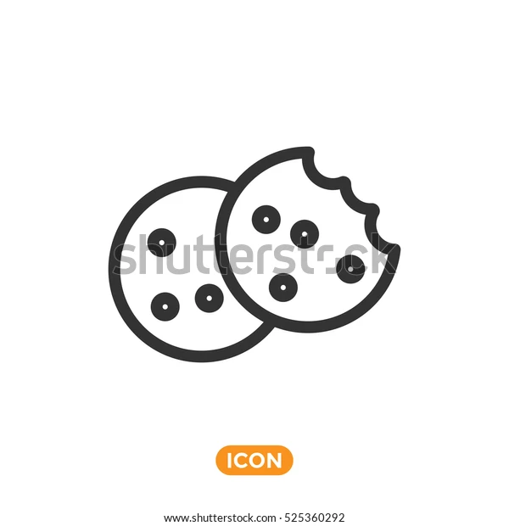

Product BenfIets
Organic:
We use an organic ingredients in all our products to provide our consumers with high quality, delicious products
Healthy:
We offer you a wide range of products that are healthy without using Hydrogenated oils or Preservatives
Diversity:
We offer a variety of products such as butter cookies, tea biscuits, chocolate chip cookies, and digestive biscuit
Technology:
We use the latest machines and techniques to provide you with a unique products with a unique taste.

Slide 3
Cateogries
- Classic Butter Cookies
- Classic Collection
- Classic Singles
- Classic Tea Biscuits
- Classic Digestive

Slide 4
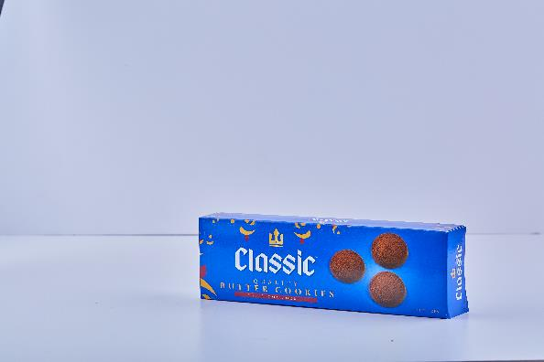
Product 1
اسم المنتج: بسكويت كلاسيك كاكاو
السعر: 14 جنيه
Product Name: Classic Cocoa Cookie
Product Price: 14 L.E
Description:
Classic Singles, which uses the same authentic Danish recipe using 100% butter with the flavor of Cocoa and it contains 12 cookies.

Slide 5
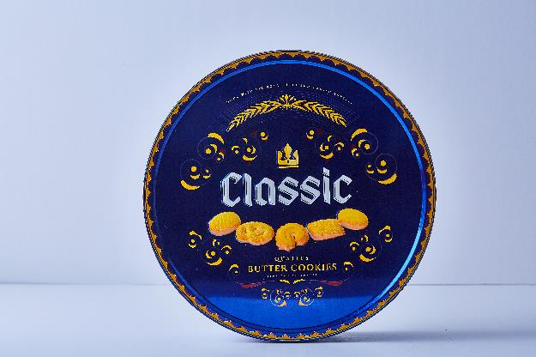
Product 2
Description:
Classic Butter Cookies is our original butter cookie recipe made from an authentic Danish recipe and made with 100% butter & the tin size is 908 GM.
اسم المنتج: بسكويت كلاسيك زبدة
السعر: 146 جنيه
Product Name: Classic Butter Cookies
Product Price: 146 L.E

Slide 6
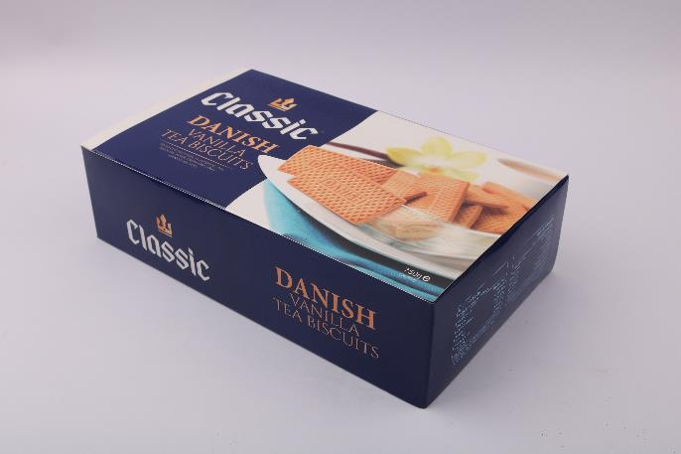
Product 3
Description:
Danish tea biscuits make a perfect companion to that cup of tea or coffee in the morning, afternoon, or evening. Using a Danish recipe these biscuits.
اسم المنتج: بسكويت دانش فانيليا
السعر: 37 جنيه
Product Name: Classic Vanilla Danish
Product Price: 37 L.E

Slide 7
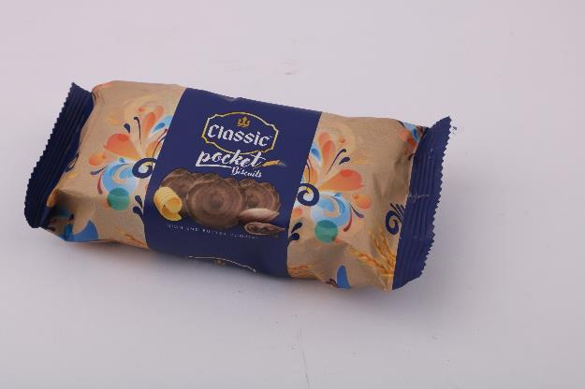
Product 4
Description:
Classic Pocket Cookies is a great choice for good snack during the day… Classic Pocket Cocoa comes in a box that contains 4 packs.
اسم المنتج: بسكويت بوكيت كاكاو
السعر: 36 جنيه
Product Name: Classic Cocoa Pocket
Product Price: 36 L.E

